Slide 1
Let’s Learn Verilog Together.
Courtesy
Dr K V Shriram

Slide 2
Introduction
Verilog is one of the HARDWARE DESCRIPTION LANGUAGES (HDL). (Verilog is not VHDL, Folks. We call it Verilog HDL, here. VHDL is different)
One can use VERILOG to describe (explain) a system. (Can take a counter, flip flop or a memory unit as an example here)
Can help in describing a design. Describing a hardware at any level is a possibility with Verilog (Why not VHDL ???, Yes, you can use that too. But, it is understood to be slightly complex than Verilog and hence I vote for Verilog)
Helps in design and debug. (An example shall help you understand this)

Slide 3
Contd.,
Verilog permits the design at
Behaviour Level
Data flow level – (RTL = Behavioural + Data Flow Model)
Gate Level and
Switch Level (Few say this, few don’t)
Want to know what is this? This is called abstraction (You can recollect your object orientation know how to understand what is abstraction)

Slide 4
Contd.,
Abstraction generally is called the amount of information an entity is hiding within it.
An example here is, human body.
We say human body is highly complex (Very huge amount of hidden information here)
Human body has brain, this many bones, this many nerves. (A little amount information is revealed)
Human body has brain which controls all the activities. Nervous system, kidney, liver etc. (More information is revealed)
So, more detailed when it goes, lesser it hides, which is low level abstraction.
Or, make this way. More the information is being hidden, it is higher the abstraction, for sure.
This can be connected to the computer now, may be mobile phones or a micro controller board with different levels of abstraction. A Simple diagram is presented below.

Slide 5


High level of abstraction
Low level of abstraction

Slide 6

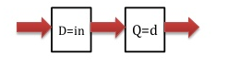
Now, connect this concept to VLSI. (4 levels of abstraction)
Behavioural or Algorithmic Level Abstraction
You should turn a programmer here.
A module can be implemented as an algorithm without having to worry about the hardware details.
It is very much like you coding in C. (So, more of programming skills needed)
Data flow
See, here it is all about specifying the data flow.
Designer shall think (expected to know) how the data flows between the registers and how are they processed with the design.
A clock will be present in this approach. Exact timing are to be specified and operations happen as scheduled. (Means, you time it buddy)

Slide 7
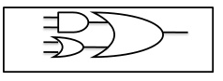
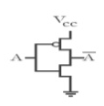
Gate Level
This approach is about the logic gates and the connection between them.
Here, the design is represented in terms of gate level logic.
Switch Level
This is the lowest level of abstraction VERILOG can provide you!! (Recollect, what is abstraction)
Storage, interconnections, switch etc. will all come to lime light. Designer requires vast knowledge at this approach.

Slide 8
Contd.,
You need not restrict yourself to only one level of abstraction.
You can have a mix of any approach.
Register Transistor Level (RTL) is an approach which combines both behavioural and data flow levels.
This is most frequently used!☺

Slide 9
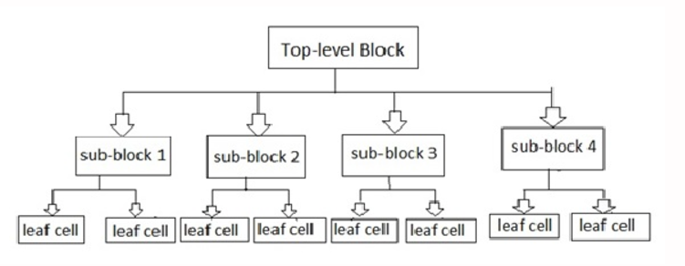
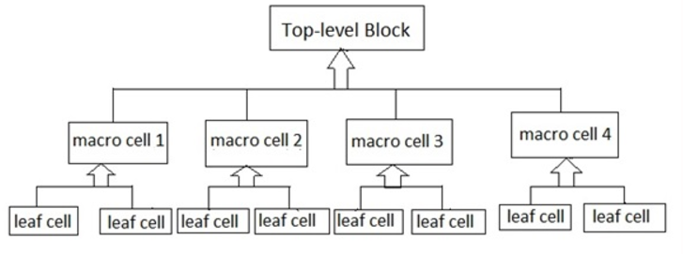
Design approach
As in programming, we have two approaches in digital design
Top Down and Bottom Up approach.
Let’s understand this through a quick view.
Top Down
Here, top level blocks identified and defined first.
Then, sub blocks would be identified.
It will grow up till leaf cells, which can’t be further divided.
Bottom Up
Identification of building blocks available.
With these cells, higher level blocks will be built.

Slide 10
Lexical Tokens
Verilog has stream of tokens.
Token can be Comments, Identifiers, Keywords, de-limiters etc.
It is just like C Programming.
Fully Case Sensitive. (Remember what C is ??)
Keywords must be in lower case.

Slide 11
Contd.,
White Space (I mean Spacebar)
/b (Blank Space), /t (Tab Space), /n (New lines) – has whitespace component.
Whitespace is ignored by Verilog (if not a separate token, it is brilliant)
Whitespace in the strings does not get ignored. (Means, it is deliberately given by the user and hence is to be respected.)
Comments
You know C programming ??? Yes, you know this, then.
Two ways. // and /*
// -> Referred as one line comment
/* used for multiple line comment */
/* This is */ Not permitted */ and is an error */

Slide 12
Contd.,
Operators
See again, C here ☺
Unary (c = ~a; ~ is an unary operator. a is the operand folks. )
Binary (c = a | | b; | | is a binary operator, a and b re the operands)
Ternary ( c = x ? y : z ; ? And : are ternary operators, where x y z are operands)

Slide 13
Number Specification – Can be Sized and Unsized
Sized numbers → <Size> ‘<Base Format> <Number>
D or d for Decimal
H or h for Hexadecimal
B or b for Binary
O or o for Octal

Slide 14
Contd.,
Unsized Numbers
Numbers specified without <base_format> are treated as decimal by default.
Without <size> if you write, it shall be machine specific.

Slide 15
Contd.,
Negative Numbers
-8 ‘d3 // 8 bit negative number stored as 2s complement of 3.
Strings
- Sequence of characters together is called strings.
“STRING” inside.
“ ONE LINE ONLY, MULTIPLE LINES NOT PERMITTED”
“Welcome to the world of Verilog” // This is a string.
“a * b + c” is also a string.

Slide 16
Lexical Conventions
Very similar to C
Verilog is case-sensitive
All keywords are in lowercase
A Verilog program is a string of tokens
Whitespace
Comments
Delimiters
Numbers
Strings
Identifiers
Keywords

Slide 17
Lexical Conventions (cont’d)
Whitespace
Blank space (\b)
Tab (\t)
Newline (\n)
Whitespace is ignored in Verilog except
In strings
When separating tokens
Comments
Used for readability and documentation
Just like C:
// single line comment
/* multi-line comment */
/* Nested comments /* like this */ may not be acceptable (depends on Verilog compiler) */

Slide 18
Lexical Conventions (cont’d)
Operators
Unary
a = ~b;
Binary
a = b && c;
Ternary
a = b ? c : d; // the only ternary operator

Slide 19
Lexical Conventions (cont’d)
Number Specification
Sized numbers
Unsized numbers
Unknown and high-impedance values
Negative numbers

Slide 20
Lexical Conventions (cont’d)
Sized numbers
General syntax: <size>’<base><number>
<size> number of bits (in decimal)
<number> is the number in radix <base>
<base> :
d or D for decimal (radix 10)
b or B for binary (radix 2)
o or O for octal (radix 8)
h or H for hexadecimal (radix 16)
Examples:
4’b1111
12’habc
16’d255
Unsized numbers
Default base is decimal
Default size is at least 32 (depends on Verilog compiler)
Examples
23232
’habc
’o234

Slide 21
Identifiers and Keywords

Slide 22
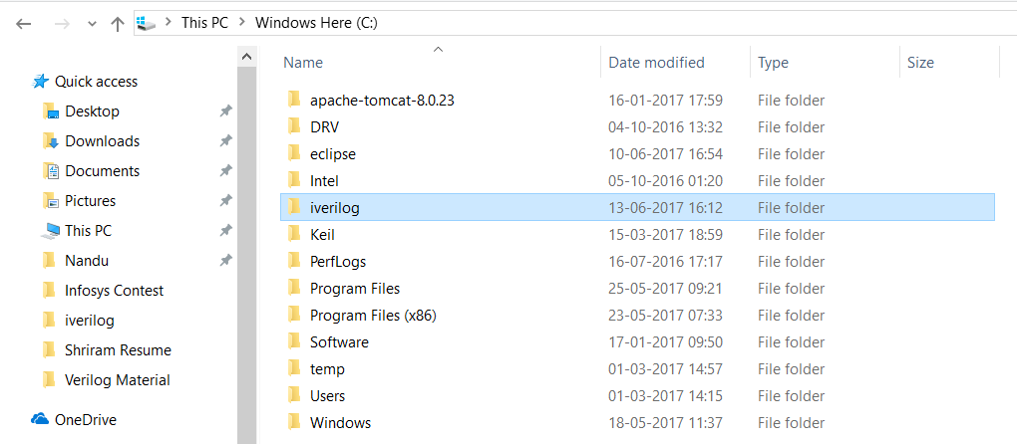
Let’s Run Verilog
Download Verilog for Windows from
http://bleyer.org/icarus/
Install it as usual.
You shall have a directory named iverilog in C drive.

Slide 23
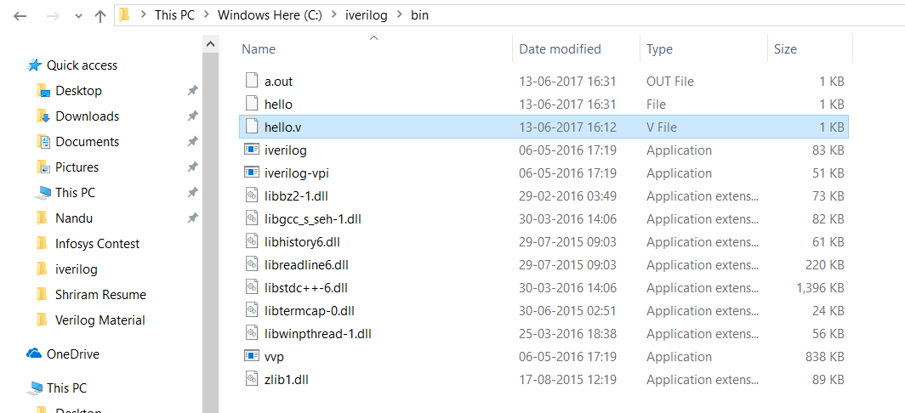
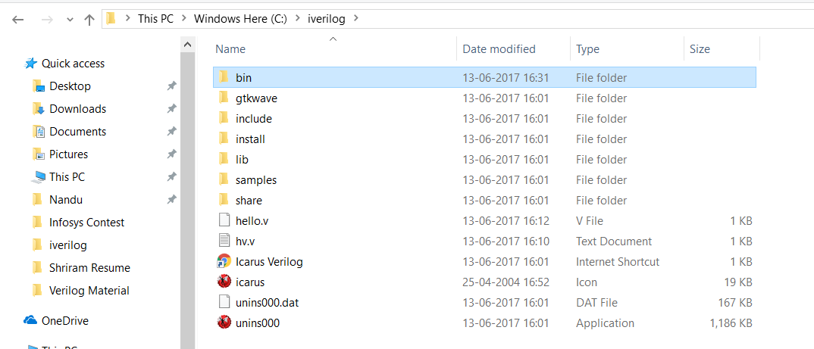
Now, go into the folder iverilog
You will have bin. Do nothing ☺
Go into bin, store your files there.
Files should have extension .v
Use notepad ++ as you can save it easily.

Slide 24
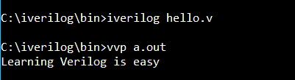
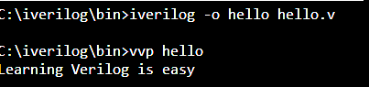
Contd.,
To run a file, you should recollect the steps we did with GCC.
It’s similar!
Go to CMD Prompt.
Navigate to C:\iverilog\bin>
Now, you can run your file. ☺ See the snapshot with both the options.
Happy Verilog Learning Folks!

Slide 25
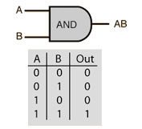
Basic things to know.
module andgatedemo (a, b, y);
input a, b;
output y;
assign y = a & b;
endmodule
module – fundamental building block for Verilog designs
This is the basic entity.
Used to construct design hierarchy
Cannot be nested (Means, a module cannot be inside another module)
One circuit is represented by set of "modules“ (Means, module makes everything). For an instance it can have a Gate, Register, ALU etc.
Module is Keyword (See LHS). A name has to follow the term module.
module andgatedemo
a, b and y are the ports. (Can be input or output, don’t worry now)
A module has to be end with endmodule (just like for ( ) closure with { }.

Slide 26
Contd.,
module andgatedemo (a, b, y);
input a, b;
output y;
assign y = a & b;
endmodule
How to declare a module?
Simple. Above steps are clear
module module_name (module_port, module_port, …);
Example: module full_adder (A, B, c_in, c_out, S); // See the above example as well. You will get more learning with this module.
How input/output declared?
Input can be a scalar or a vector.
input list of input identifiers;
Example: input A, B, c_in;
Output again can be scalar or a vector.
output c_out, OV, MINUS;
output[7:0] ACC, REG_IN,

Slide 27
Contd.,
module andgatedemo (a, b, y);
input a, b;
output y;
assign y = a & b;
endmodule
End module
endmodule – ends a module – not a statement
no “;”. See the above piece of code.
It is like opening the loop and closing it to show the finish

Slide 28
Contd.,
module andgatedemo (a, b, y);
input a, b;
output y;
assign y = a & b;
endmodule
With Assign, inputs and outputs are connected via AND gate.
A ANDed with B and will be connected to Y.
Nothing is stored in this scenario and hence there is no need for a register at all. In case we store, we need register.

Slide 29
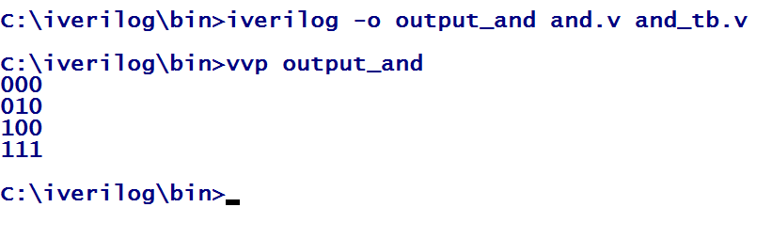
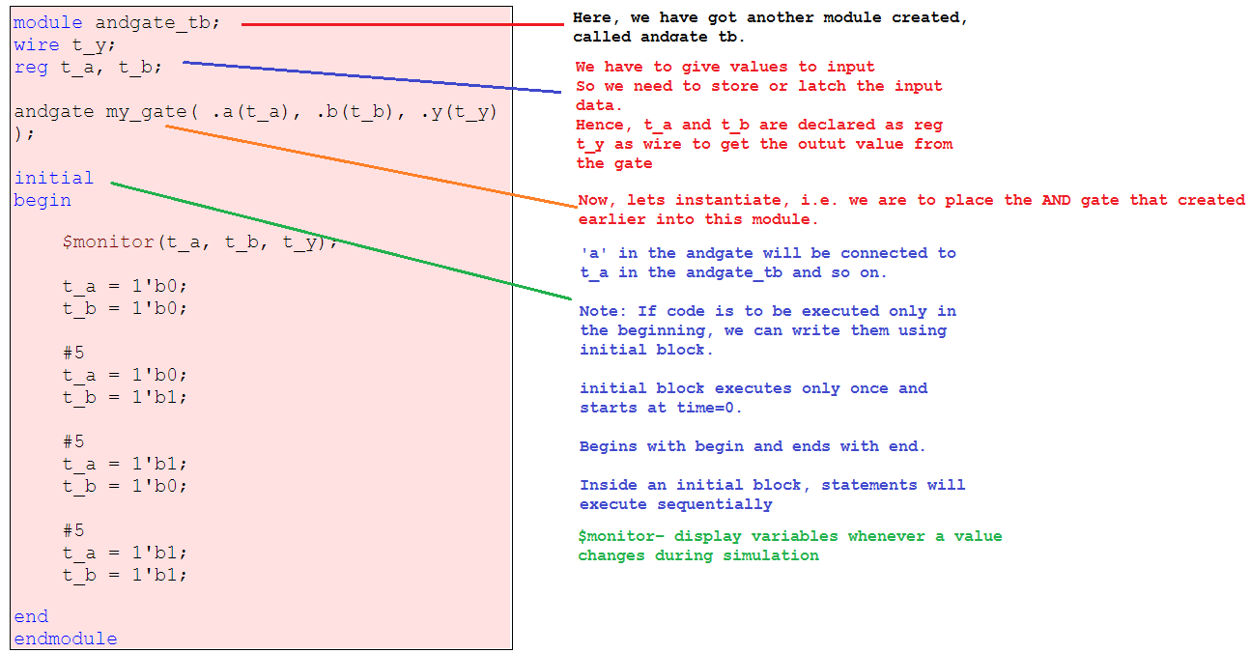
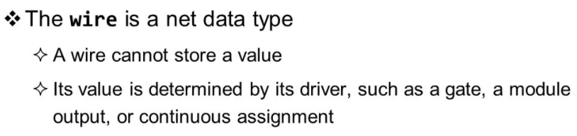
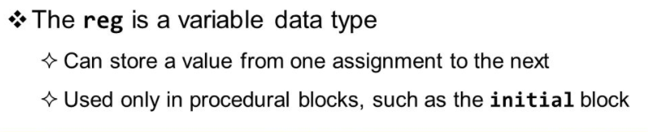
Test Bench
We need to test what we have written, right?
Yes, for that we have testbench. It is also Verilog code which will send the inputs to the circuit to be tested. It is a tester, you can say ☺
#5 indicates a delay of 5ns.

Slide 30
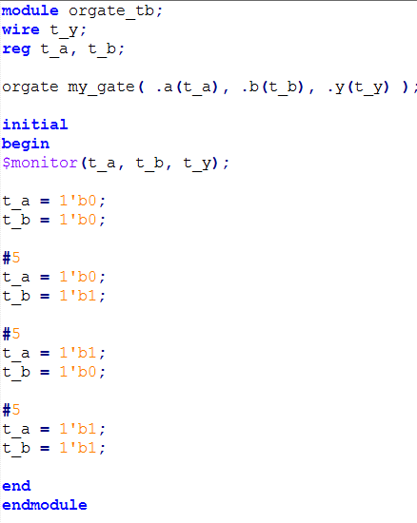
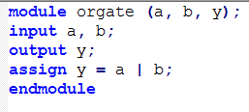
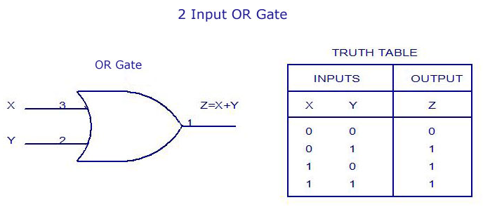
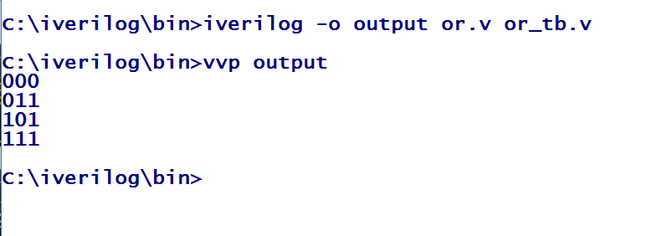
OR GATE
Test bench
MODULE

Slide 31
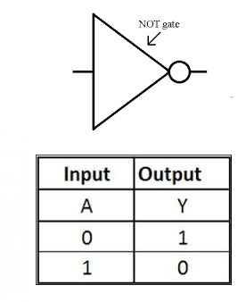
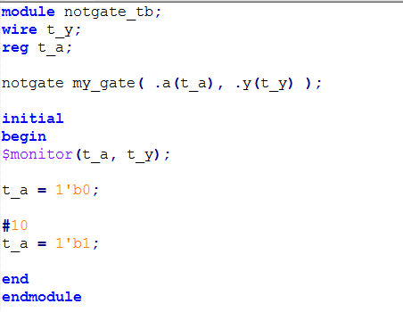
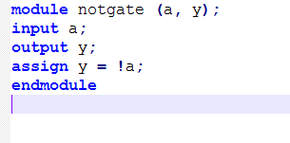
NOT

Slide 32
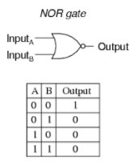
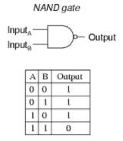
Code for NOR, NAND
Do these yourself, XOR, XNOR etc. They are part of your syllabus!!! ☺

Slide 33
Lets code for Universal Gates (NAND and NOR)
AND, NOT and OR gates are the basic gates;
Now NOR gate and NAND gates have the particular property that any one of them can create any logical Boolean expression if designed in a proper way. (So, called as Universal Gates)

Slide 34
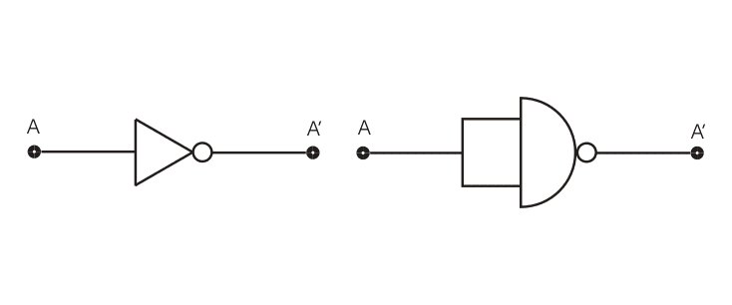
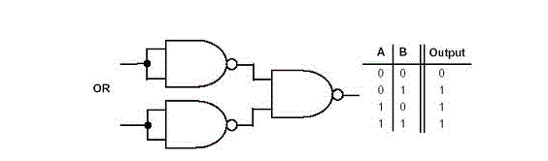
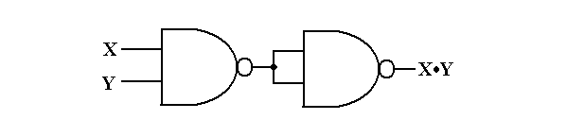
NAND as Universal Gate
NAND as AND
NAND as NOT
NAND as OR
NOR IS YOUR EXERCISE!!
Make NOR as AND, OR and NOT.

Slide 35
Let’s understand combinational circuit with VERILOG
Shriram K Vasudevan

